Slide 1





Scraping for Desired Skills on Job Boards

Slide 2





Team 23
Kate Zagrebneva
Prashasti Sharma
My Han Mai
Noor Zia
Samira Shafiei

Slide 3

Mission

Slide 4
To assist other business analytics and data analytics students in their career development journey by identifying and ranking actual desired skills listed in role-targeted, real-world job listings

Slide 5
What among our current and expected-to-gain skill sets are actually relevant to the job market?

Slide 6









Project Objectives

Slide 7


Identify the best cities with data-focused job positions
Identify the desired skills listed by employers
Rank skills based on how often it occurs across all job listings
Find the best skills combination for different types of data roles

Slide 8

Program Used
Notes:
Nltk
Bokeh
wordcloud

Slide 9

Exploratory
Analysis

Slide 10


How we got the data
Source: Indeed.com
Keyword: “Data Analyst”
Filtered for top 10 US Cities
Webscraped with Apify.com (free!) to JSON files

Slide 11
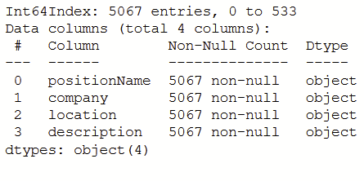
Preprocessing
Merge all data frames (each city had a dataframe)
Drop unnecessary columns
Convert everything to lowercase
Drop duplicates
Separate senior roles
Separate remote jobs

Slide 12
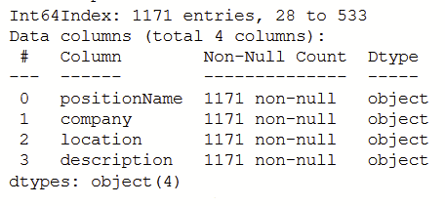
Senior Positions
We decided to focus on junior jobs and drop senior positions

Slide 13
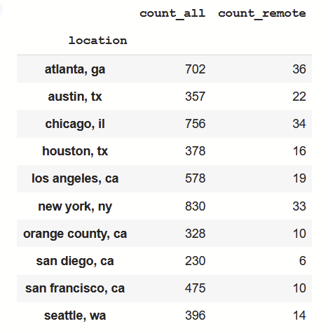
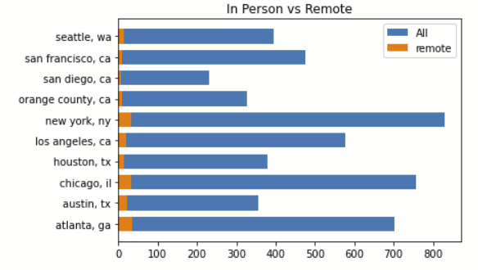
Remote Positions

Slide 14

Map Visualization

Slide 15
Analysis

Slide 16
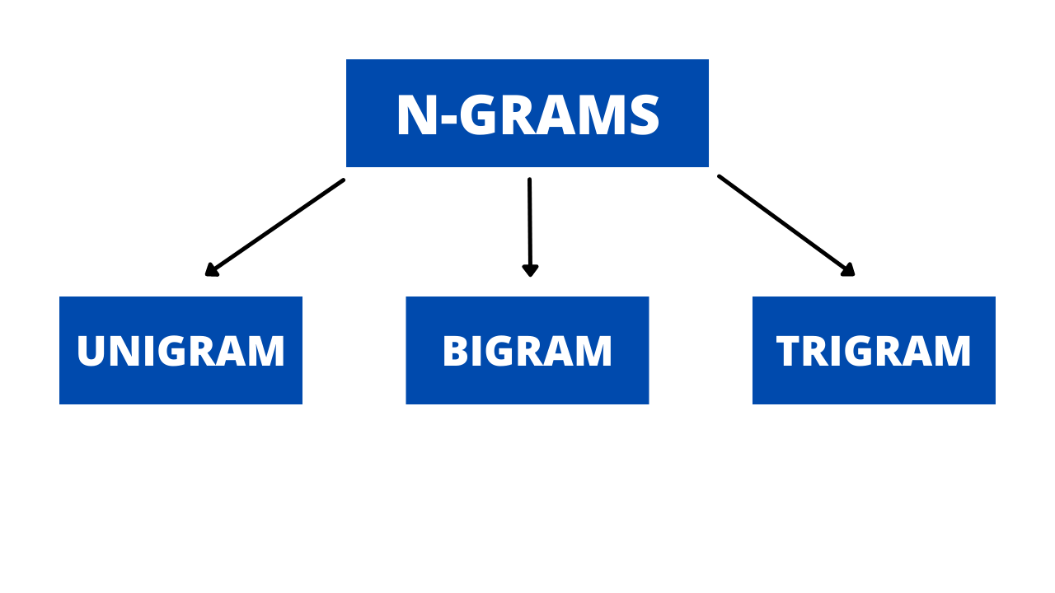

Slide 17
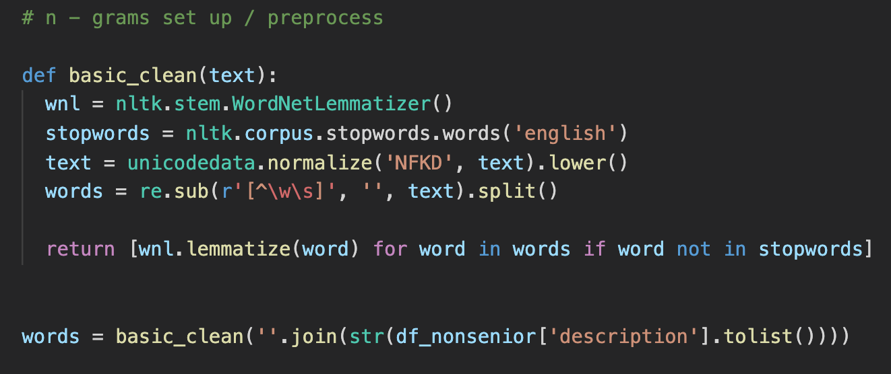
N-Grams Preprocess

Slide 18
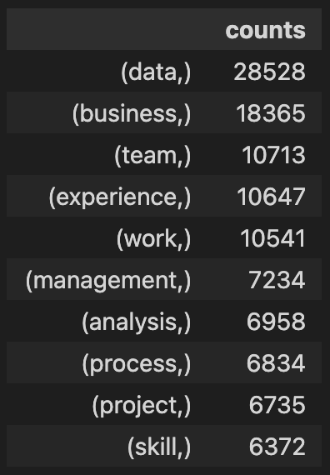
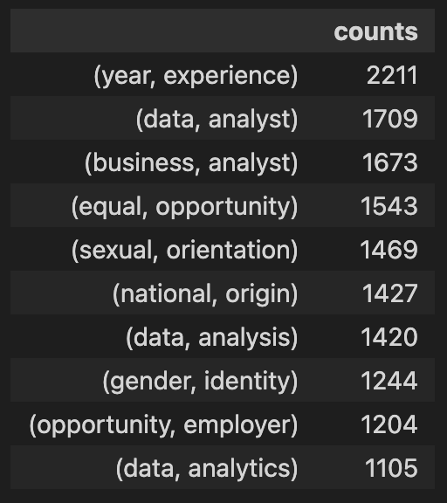
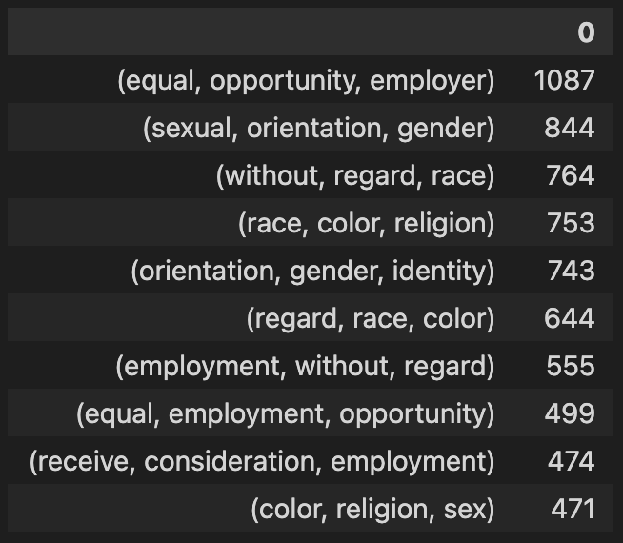
Exploratory N-Gram Analysis Results
Do NOT provide sufficient insights

Slide 19
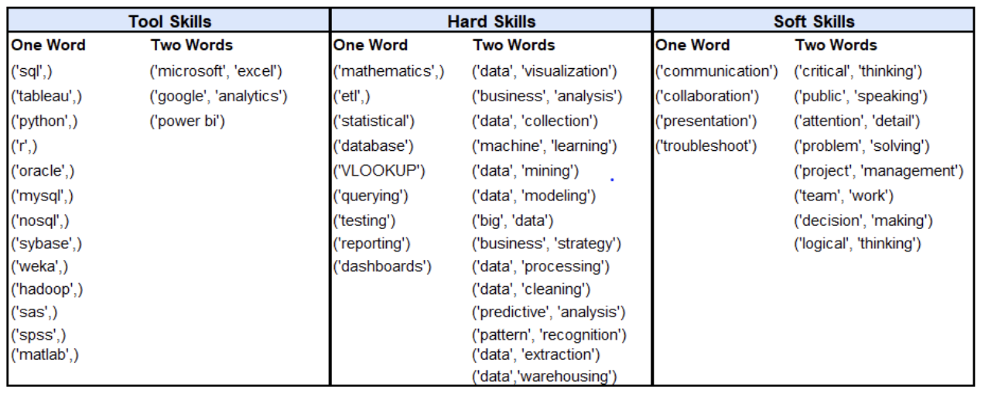
Chosen Skills

Slide 20
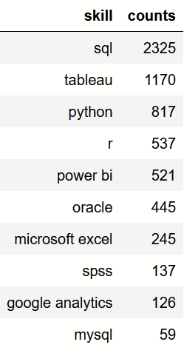
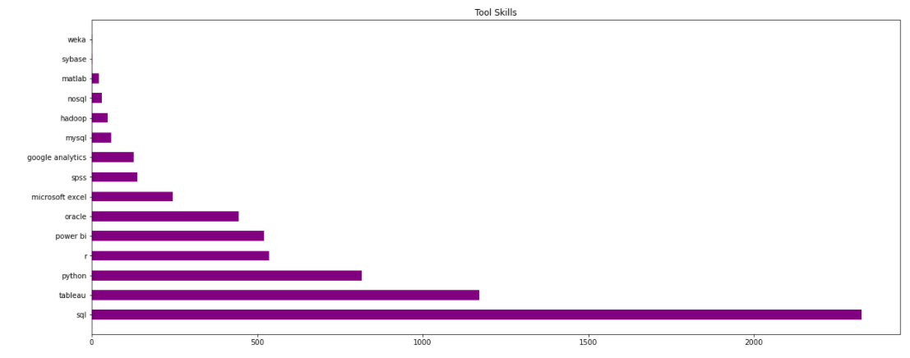
Technical Skills

Slide 21
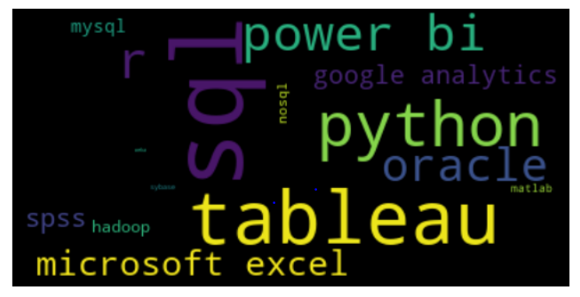
Technical Skills

Slide 22
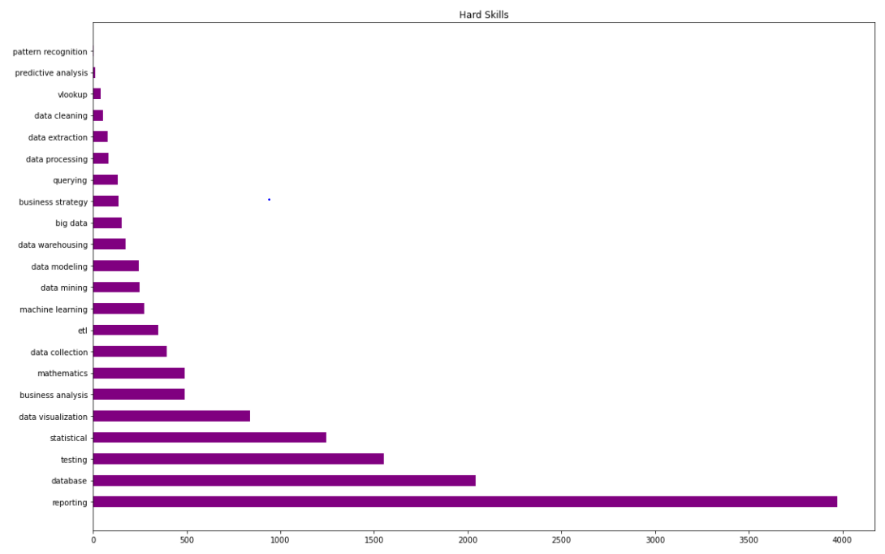
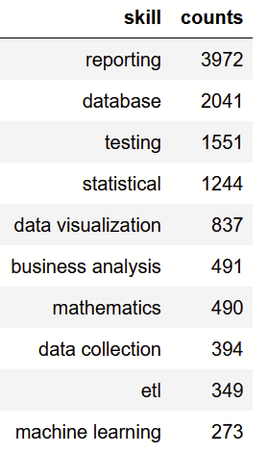
Hard Skills

Slide 23
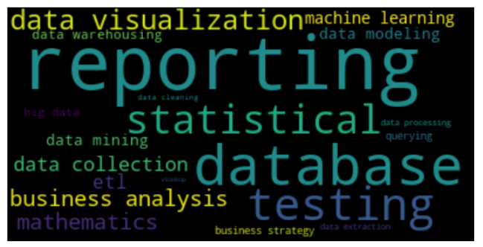
Hard Skills

Slide 24
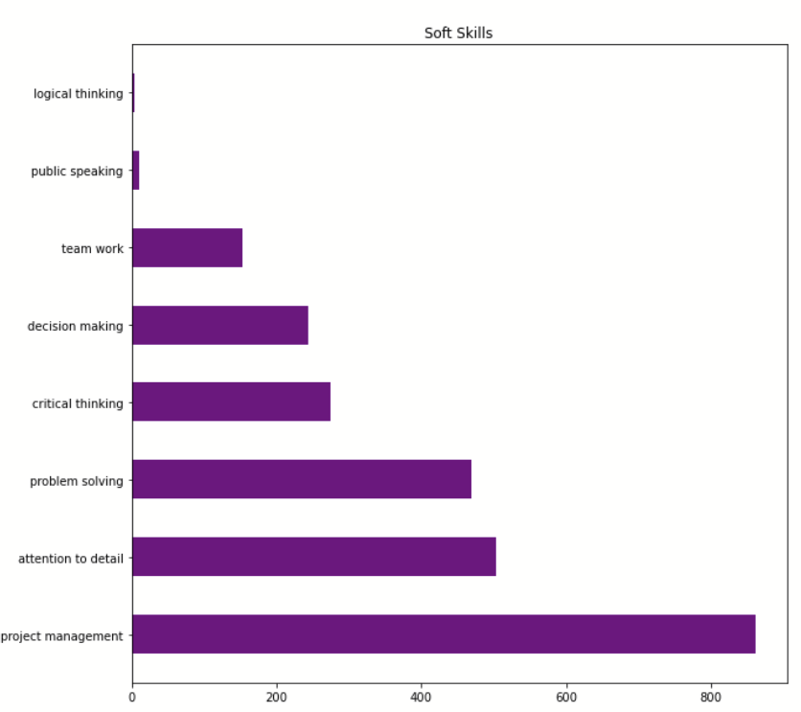
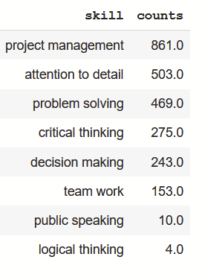
Soft Skills

Slide 25
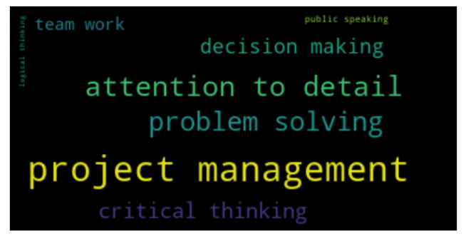
Soft Skills

Slide 26
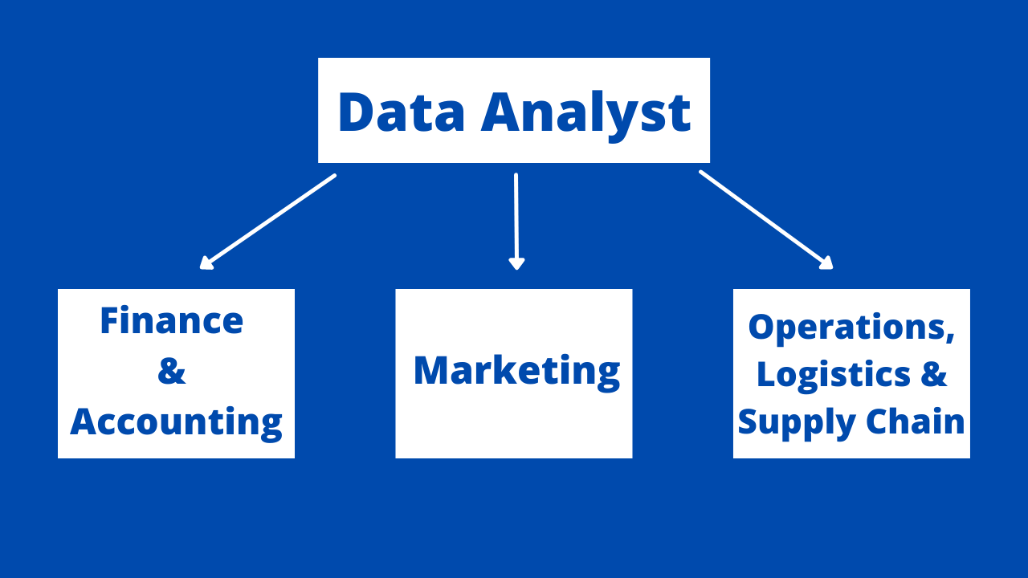
Department Specific Analysis

Slide 27
Position-focused skills
Department-specific
Finance | Tools: Sql, Oracle, Tableau, PowerBi, Python Hard Skills: Reporting, Statistical, Database, Testing, Data Visualization Soft Skills: Problem Solving, Project Management, Detailed Oriented, Decision Making, Critical Thinking
Marketing | Tools: Sql, Tableau, Google Analytics, Python, R Hard Skills: Reporting, Database, Data Visualization, Statistical, Testing Soft Skills: Attention to Details, Problem Solving, Project Management, Team Working, Critical Thinking
Operations | Tools: Sql, Tableau, PowerBi, Python, Microsoft Excel Hard Skills: Reporting, Database, Testing, Statistical, Data Visualization Soft Skills: Project Management, Problem Solving, Attention to Details, Critical Thinking, Team Work
Notes:
Highlighted the ones that rank higher for specific department

Slide 28
Conclusions

Slide 29
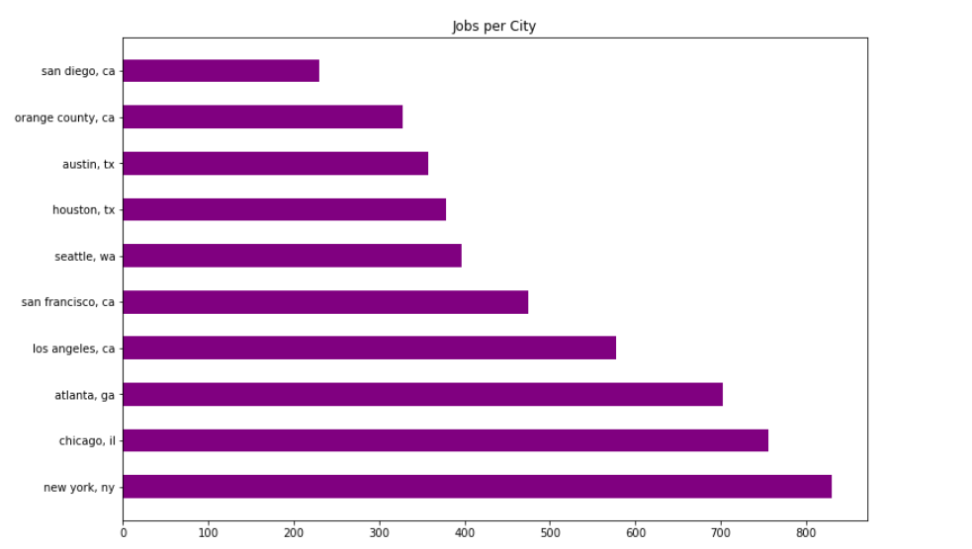
Best Cities for Data Roles
New York
Chicago
Atlanta
Notes:
As you all can see, the graph shows the number of data analyst jobs per cities. Among these cities Newyork,Chicago and Atlanta offers the greatest number of Job Offerings. So you got be focus on these cities when applying for the data analyst jobs.

Slide 30
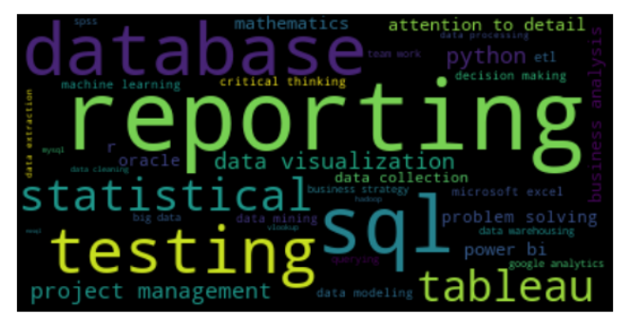
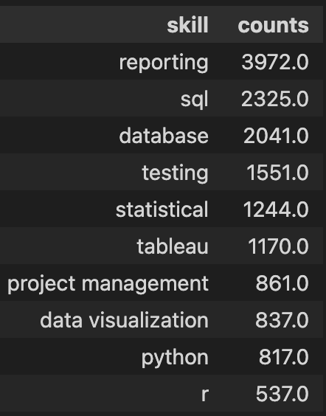
All Skills
Notes:
This word cloud is showcasing the combination of some of the popular skills. The size of the word represents the frequency of the skill in the job descriptions. Reporting having the highest frequency to R having the lower frequency.

Slide 31
Top 5 Overall Skills
Reporting
Hard Skill
SQL
Tool/Technical Skill
Database Management
Hard Skill
Testing
Hard Skill
Statistical Analysis
Hard Skill
Notes:
This visualization represents the Top 5 skills from the combination of all three sets of skills. Even though we added soft skills but none of them make it to top 5 skills

Slide 32
Top 5 Tools
SQL
Tableau
Python
R
Power BI
Notes:
Sql, Tableau, Python, R and power Bi are the Top 5 hard skills that a prospective data analyst should have.

Slide 33
Job-based Skills
Finance
Oracle
Python
Marketing
Data Visualization
Google Analytics
Operations
PowerBi
Microsoft Excel
Notes:
As the analysis showed, departments like financial, marketing or operation requires different top skills. For instance for fiance data analyst needs to know Oracle and Power BI, while marketing data analyst has to have experience with data visualization and Google Analytics. And lastly for Operations data analyst also needs to Power BI & Microsoft excel. The rest of the resume can be generalized for all kind of data analysts.

Slide 34

Thank You !
Any questions?
Notes:
Thank you, feel free to ask any questions.

